Slide 1

Emerging Resistant Pathogens
Steve Mahlen, PhD, D(ABMM)
Sanford Bismarck

Slide 2
Case #1
1 yo female
  Respiratory arrest, chicken bones in the throat
  Emergency surgery to remove bones
  After surgery developed aspiration pneumonia and hypoxic encephalopathy
    Mechanical vent; central cath
  Hospital day 37
    Candida albicans recovered from blood cultures
      Repeatedly recovered for 18 d
  Day 46: started on amphotericin B
  Day 49: therapy changed to fluconazole
  Days 51, 54: recovered C. albicans and another yeast

Slide 3
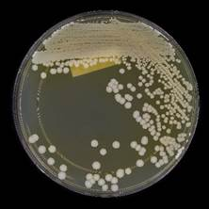
Case #1
Other yeast (days 51 & 54)
  Cream-colored colonies on Saboraud dextrose agar
  Cornmeal agar: no chlamydoconidia or pseudohyphae
  Did not grow on cycloheximide-containing medium
  Grew well at 37-42°C, not at 45°C
  Vitek2 yeast ID card: Candida haemulonii
  API 20C (yeast ID): Rhodotorula glutinis
  Resolved by fungal DNA sequencing

Slide 4
Case #2
64 yo male evaluated for chronic otitis externa
  2-y history of recurrent ear complaints
  9 months prior had otomycosis (bilateral ear pain, drainage of “cheesy” serous fluid from one ear), treated topically with drops
    Clinically diagnosed
  3 months prior: oral surgery in India, complicated by odontogenic brain abscess
    Hospitalized for 24 days in India
    CT scan there showed chronic otitis media
    Brain abscess aspirate sequencing negative for mycobacteria and fungi, positive for Streptococcus mitis
  Ear drainage sent for bacterial and fungal culture
    A yeast was recovered, identified by MALDI-TOF (only ID test the lab performed)

Slide 5


What is this yeast?
Former Kansas State defensive back Russ Yeast

Slide 6
Candida auris
First described in Japan in 2009
  From an ear infection
Retrospectively, earliest known infections occurred in South Korea in 1996
CDC issued a warning about C. auris in 2016
  Rapid global dispersal
Detected in >30 countries

Slide 7
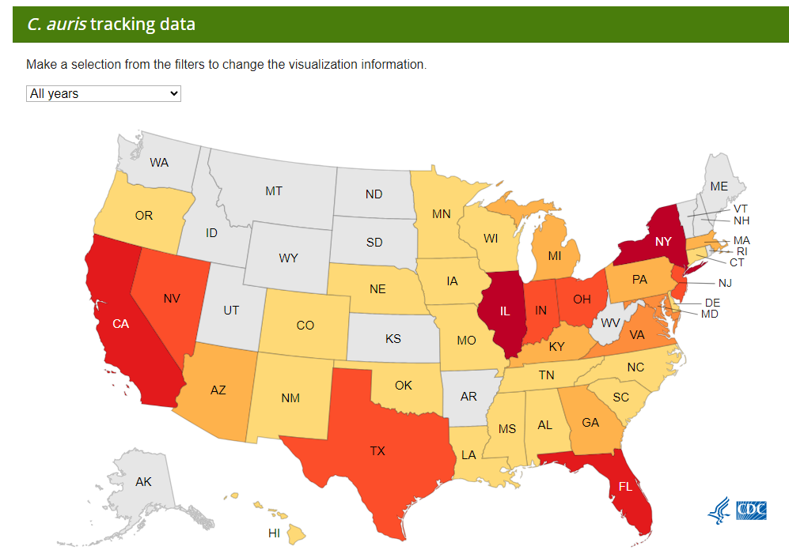
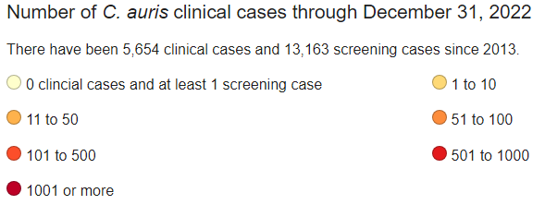
>30 states
Most cases in NY City, NJ, Chicago

Slide 8
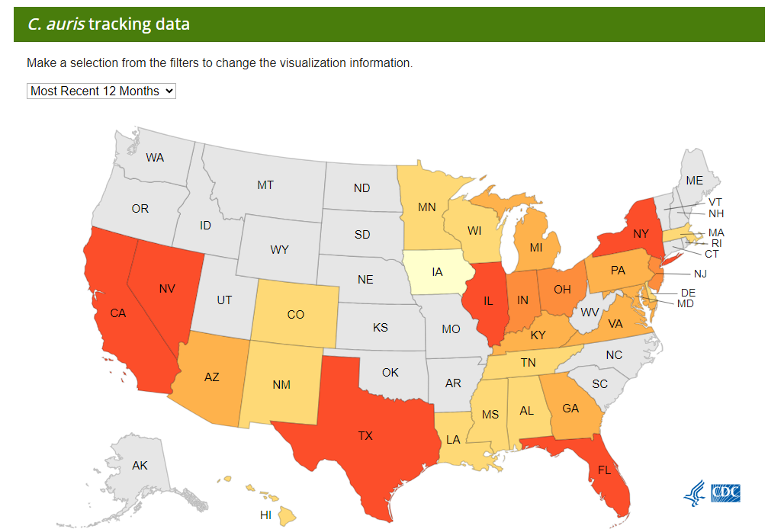
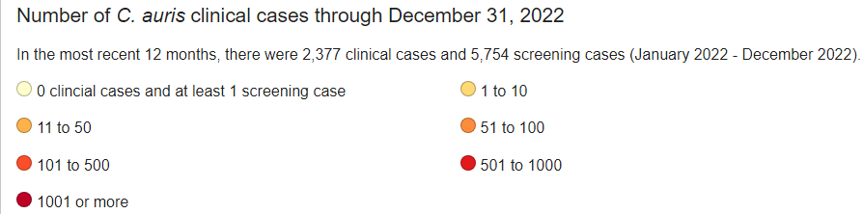
https://www.cdc.gov/fungal/candida-auris/tracking-c-auris.html

Slide 9
C. auris
Risk factors
  Underlying medical conditions
  Extensive exposure to health care facilities
  Invasive medical devices: mechanical ventilation, tracheostomies, feeding tubes, urinary catheters
Associated with healthcare setting outbreaks
  Particularly long-term-care facilities
  9/2018, southern California
    Proactive (lab surveillance): ID of Candida isolates from urine from patients in long-term acute care facilities
      1st identified 2/2019
    Identified 182 cases, 17 facilities
    Contained by 10/2019
    Gaps in hand hygiene, transmission-based precautions, environmental cleaning
      Importance of public health oversight

Slide 10
C. auris: Identification (misidentification)
Revisit the first case:
  Vitek2 yeast ID card (YST): Candida haemulonii
  API 20C (yeast ID): Rhodotorula glutinis

Slide 11
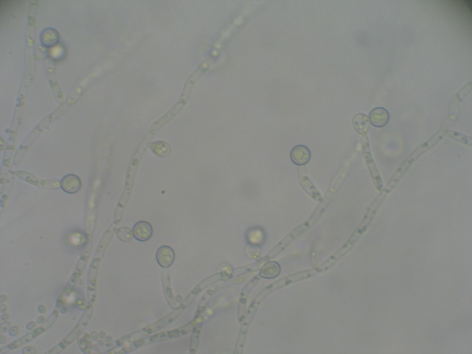
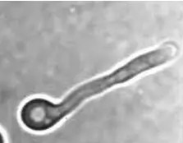
C. auris: Identification
Very difficult just based on growth characteristics
Budding yeast
Rarely forms pseudohyphae on corn meal agar
Does not form germ tubes
Grows well at 40-42°C
Inhibited by cycloheximide
C. albicans on corn meal agar
C. albicans germ tube
Notes:
Mycosel has cycloheximide, will not grow. Many yeast do not grow well at 42.

Slide 12
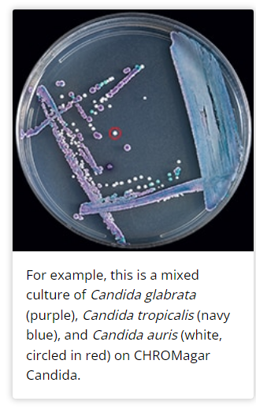
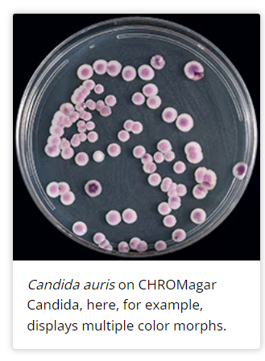
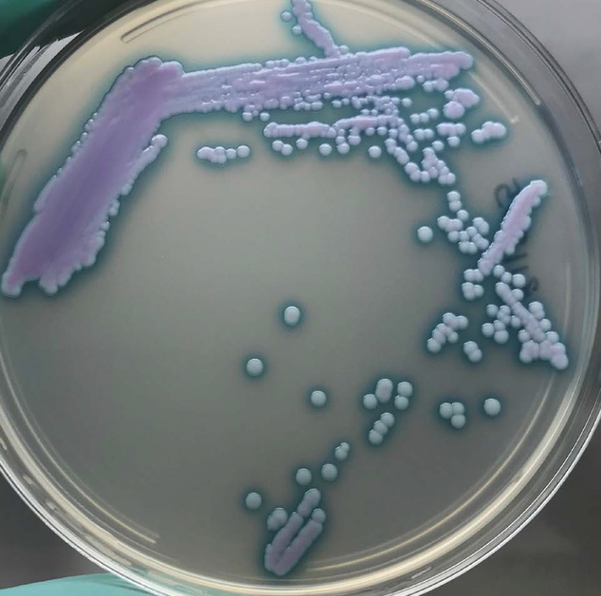
CHROMagar Candida: pinkish, blueish, can be white
Lockhart SR, Lyman MM, Sexton DJ.2022.Tools for Detecting a “Superbug”: Updates on Candida auris Testing. J Clin Microbiol60:e00808-21.https://doi.org/10.1128/jcm.00808-21
https://www.cdc.gov/fungal/candida-auris/identification.html

Slide 13
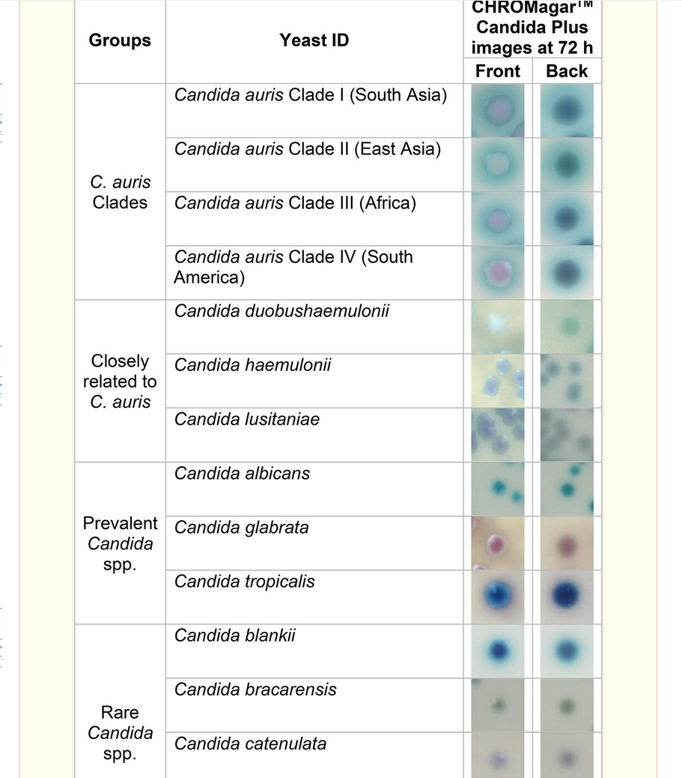
Marathe A, Zhu Y, Chaturvedi V, Chaturvedi S. Utility of CHROMagar™ Candida Plus for presumptive identification of Candida auris from surveillance samples. Mycopathologia. 2022 Dec;187(5-6):527-534. doi: 10.1007/s11046-022-00656-3. Epub 2022 Nov 10. PMID: 36355325; PMCID: PMC9647746.

Slide 14
C. auris: identification
ID systems/biochemical panels:
  Since C. auris is fairly new, was not in databases
  Also, closely related to other yeasts for assimilation and fermentation tests
  There are also 4 major clades of the organism
    Each clade has slightly different assimilation/fermentation profiles, and slight differences in DNA sequences
Notes:
There are truthfully 5 clades, but one has only been found in Iran so far

Slide 15
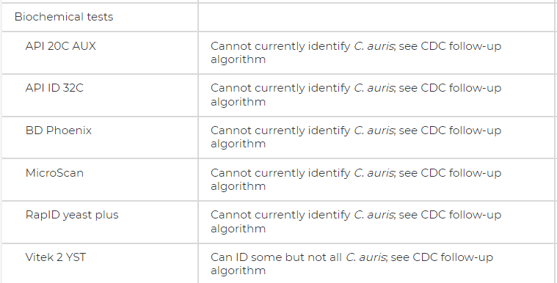
Lockhart SR, Lyman MM, Sexton DJ. 2022. Tools for Detecting a “Superbug”: Updates on Candida auris Testing. J Clin Microbiol60:e00808-21.https://doi.org/10.1128/jcm.00808-21

Slide 16
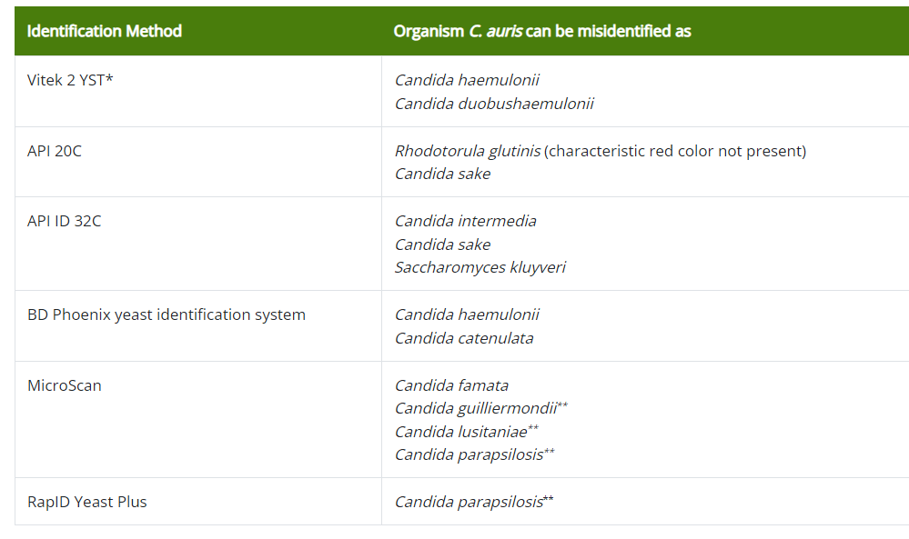
Non-molecular,
non-MALDI-TOF
methods
https://www.cdc.gov/fungal/candida-auris/identification.html

Slide 17

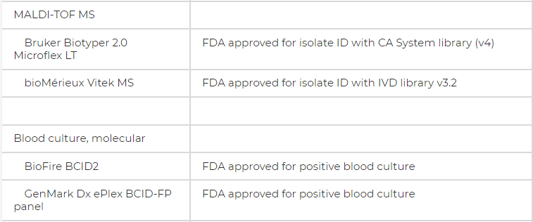
C. auris: identification
Revisit the second case ID:
  They only used MALDI-TOF MS
  Were able to successfully ID C. auris
All 4 major clades can be successfully identified with both MALDI-TOF-MS systems
Also approved with BioFire and GenMark from positive blood cultures
There are currently no FDA-approved tests for colonization swabs
Notes:
Vitek MS, Bruker

Slide 18
C. auris: case follow-up
Case 1 revisited:
  Days 51, 54 recovered C. albicans and C. auris
    Being treated with fluconazole
  C. auris recovered again on day 60
  Day 61, removed central venous catheter
    Blood cultures became negative
    Fluconazole continued for 48 more days
  Patient completely recovered

Slide 19
C. auris: case follow-up
Case 2 revisited:
  Performed susceptibility testing
    Resistant to fluconazole and amphotericin B
  Over a 6-week period, C. auris recovered from 4 repeat swabs of ear discharge
  A tympanostomy tube was placed in the ear
  Treated topically
Class | Drug | Tentative MIC Breakpoints | Results from C. auris isolate | Interpretation
Azoles | Fluconazole | ≥32 µg/mL | 128 µg/mL | Resistant
Polyenes | Amphotericin B | ≥2 µg/mL | 2 µg/mL | Resistant
Echinocandins | Micafungin | ≥4 µg/mL | 0.5 µg/mL | Susceptible

Slide 20
C. auris: susceptibility testing and treatment
Susceptibility breakpoints for C. auris have not been established
  CDC has tentative breakpoints; not endorsed by CLSI
C. auris is considered multidrug resistant
  Intrinsic resistance to agents from several antifungal classes, particularly azoles (fluconazole)
Treatment with an echinocandin, such as micafungin or caspfungin, is recommended

Slide 21
C. auris: Infection Prevention
Is a multi-drug resistant organism
Infection flag for patients with C. auris infection
Contact isolation
Can persist on plastics for at least 14 days
Recovered from mattresses, furniture, sinks, medical equipment in hospitals/care facilities

Slide 22
So why is C. auris so bad?
Tough to identify
Multi-drug resistant and is difficult to treat
Causes severe infections
US hospital database review:
  2017-2022
  192 C. auris-associated hospitalizations
    38 (20%) were bloodstream infections
  Estimated mortality rate: 34%
Infection Prevention issue
  Highly transmissible
Benedict K, Forsberg K, Gold J, Baggs J, Lyman M. Candida auris‒Associated Hospitalizations, United States, 2017–2022. Emerg Infect Dis. 2023;29(7):1485-1487. https://doi.org/10.3201/eid2907.230540

Slide 23
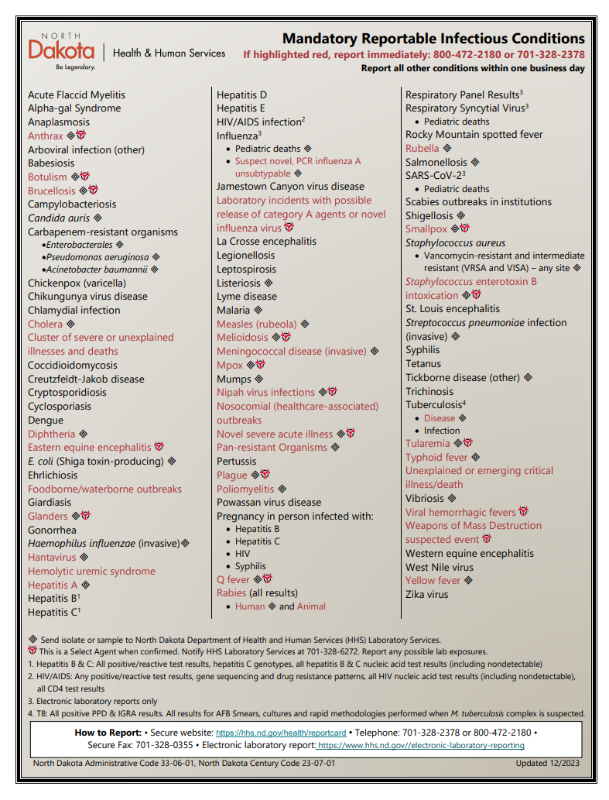
C. auris is reportable, and
isolate must be sent
to ND HHS
https://www.hhs.nd.gov/sites/www/files/documents/DOH%20Legacy/Reportable%20Conditions%20-%20Dec%202023.pdf

Slide 24
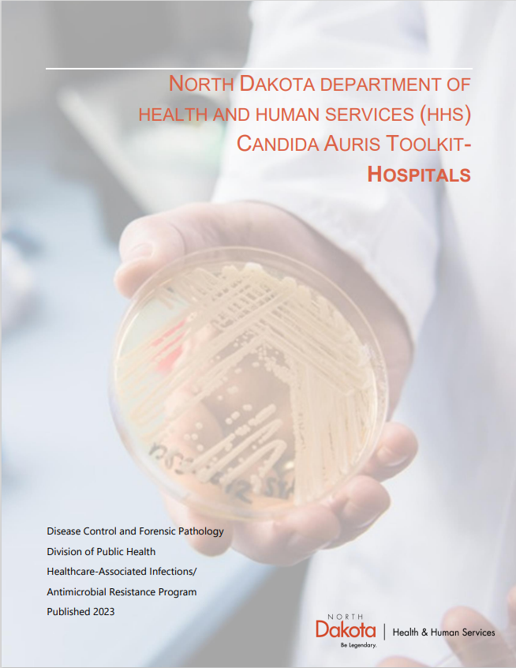
https://www.hhs.nd.gov/sites/www/files/documents/DOH%20Legacy/HAI/Candida_Auris_Toolkit_Hospitals_Final.pdf

Slide 25

When you’ve been sitting at a talk and realize it’s only half over

Slide 26
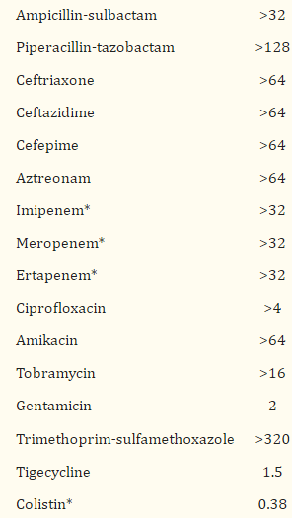
Index case
October, 2008, hospital in Italy
Inpatient, complicated intra-abdominal infection
Klebsiella pneumoniae recovered, very resistant
DNA sequencing revealed 4 different beta-lactamase genes
  One was for KPC (Klebsiella pneumoniae carbapenemase)
First KPC in Italy
Patient had not traveled, but the KPC strain resembled strains from Israel, where one of the physicians came from

Slide 27
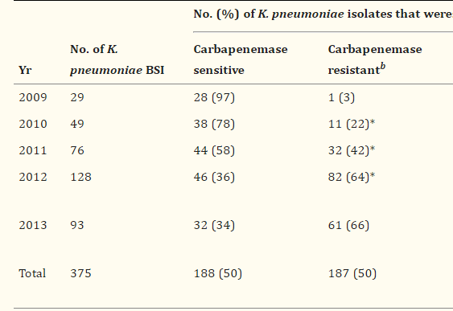
Subsequently at the same hospital…
Looked at bloodstream infections (BSI)
They had one KPC-producing K. pneumoniae in 2009 (3%)
  Increased markedly over the next few years
  Stabilized at 2/3 of cases
  (Number of BSI cases increased as well)
  PFGE: 81% of strains were the same
Giani T, Arena F, Vaggelli G, Conte V, Chiarelli A, Henrici De Angelis L, Fornaini R, Grazzini M, Niccolini F, Pecile P, Rossolini GM. Large Nosocomial Outbreak of Colistin-Resistant, Carbapenemase-Producing Klebsiella pneumoniae Traced to Clonal Expansion of an mgrB Deletion Mutant. J Clin Microbiol. 2015 Oct;53(10):3341-4. doi: 10.1128/JCM.01017-15. Epub 2015 Jul 22. PMID: 26202124; PMCID: PMC4572530.

Slide 28
Carbapenem resistance
Carbapenem antibiotics
  Meropenem
  Imipenem
  Ertapenem
  Doripenem
Carbapenem-resistant organisms (CRO)
  We primarily worry about this in gram-negative bacteria
  Carbapenem-resistant Enterobacterales (CRE)
    CDC: resistant to at least one carbapenem or produce a carbapenemase enzyme
  Carbapenem-resistant Pseudomonas aeruginosa (CRPA)
  Acinetobacter baumanii-calcoaceticus complex

Slide 29
Carbapenem resistance: mechanisms
Carbapenemases
  Enzymes that inactivate carbapenem antibiotic
Non-enzymatic mechanisms:
  Porin mutations
  Efflux pumps
  Penicillin-binding protein alterations

Slide 30
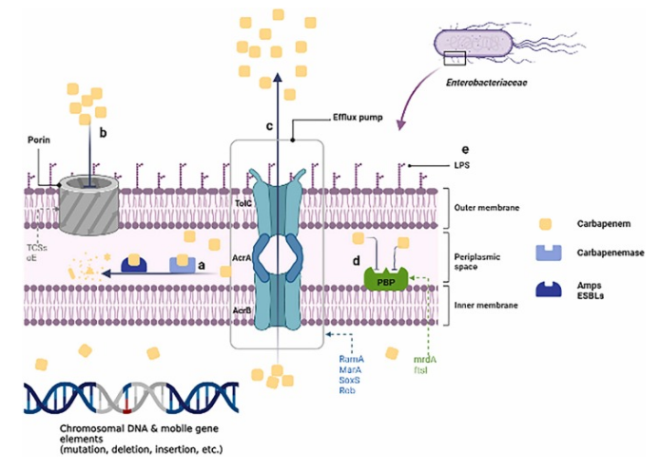
Ma J, Song X, et al. Global spread of carbapenem-resistant Enterobacteriaceae: Epidemiological features, resistance mechanisms, detection and therapy. Microbiol Res. 2023 Jan;266:127249. doi: 10.1016/j.micres.2022.127249. Epub 2022 Nov 4. PMID: 36356348.

Slide 31
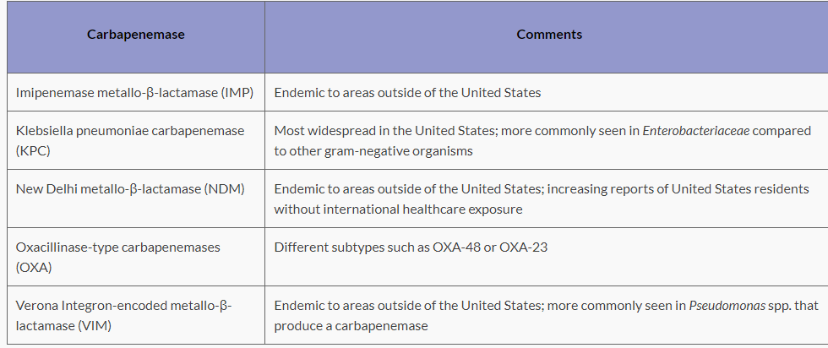
Most common carbapenemases
Most common in U.S.
Most common in
Canada and Mexico?
Most common in
Acinetobacter
Most common in Pseudomonas aeruginosa

Slide 32
Distribution of carbapenemases in North and South America
Fairly limited data
Ma J, Song X, et al. Global spread of carbapenem-resistant Enterobacteriaceae: Epidemiological features, resistance mechanisms, detection and therapy. Microbiol Res. 2023 Jan;266:127249. doi: 10.1016/j.micres.2022.127249. Epub 2022 Nov 4. PMID: 36356348.

Slide 33
Prevalence of CRE
Highest rates are in Russia, eastern Mediterranean, India, SE Asia
U.S.: ~12,000 CRE infections/year in hospitalized patients
  2017: Estimated to cause 1,100 deaths, with attributed healthcare costs of $130 million
U.S.: About 30% of CRE isolates produce carbapenemase
  If resistant to every carbapenem, 60% of time is due to carbapenemase

Slide 34
CRE risk factors
Prior colonization or infection with a carbapenemase-producing organism
Recent travel (i.e., within the prior 12 months) to countries with high prevalence of carbapenemase-producing organisms (eg, India, Greece, Pakistan, Turkey, Croatia), particularly if health care exposure occurred in the country
Trauma
Diabetes
Malignancy
Organ transplantation
Mechanical ventilation
Indwelling urinary or venous catheters
Overall poor functional status or severe illness
Residence in a long-term care facility
UpToDate: Carbapenem-
resistant E. coli, K. pneumoniae,
and other Enterobacterales (CRE)

Slide 35
CRE transmission
Humans usually acquire by direct contact:
  Another individual with CRE
  Environmental surface/substance contaminated with CRE
In hospitals:
  Poor hand hygiene
  Hospital equipment, such as stethoscopes, endoscopes
  Sinks, toilets
Infection prevention:
  Usually place infection flags on patients with CRO/CRE
  Contact isolation

Slide 36
So how do we diagnose?
Generally starts with susceptibility testing in the micro lab
  So CRE detection is not that difficult
  But CRE detection does not mean that the isolate produces a carbapenemase
To detect carbapenemase:
  Phenotypic tests
    Sensitive
    Do not tell you which carbapenemase is present; just “yes” or “no”
  Genotypic tests
    Sensitive
    Limited to the most common carbapenemase genes
    More expensive
    Easier to perform

Slide 37
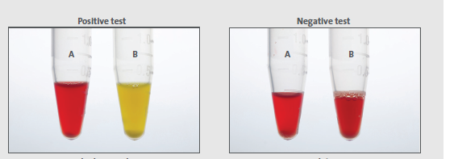
Carbapenemase detection: phenotypic
CarbaNP
  Needs special reagents, including a solution with a carbapenem like imipenem
    And some reagents need in-house prep
    Short shelf lives
  Emulsify loopful of suspected organism in solution with carbapenem and phenol red solution
  If organism produces carbapenemase, solution will change color
    Within 2 hours
CLSI, M100, 34th edition, 2024

Slide 38
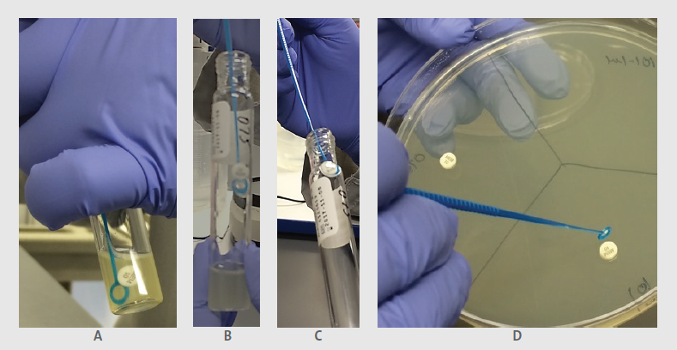
Carbapenemase detection: phenotypic
mCIM (modified carbapenem inactivation method)
  Emulsify suspected colony in TSB and add carbapenem disk (usually meropenem)
  Incubate for 4 hours
  Inoculate an MHA plate with ATCC 25922 E. coli (susceptible to carbapenems)
  Place the meropenem disk onto the MHA plate, incubate overnight

Slide 39
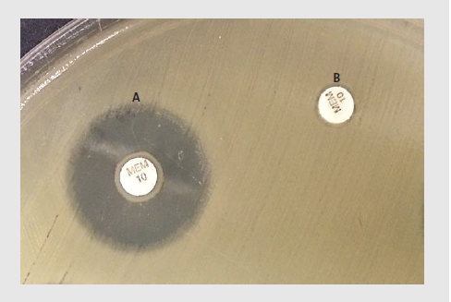
Carbapenemase detection: phenotypic
mCIM (modified carbapenem inactivation method)
  If the suspect organism produces carbapenemase, will inactivate the meropenem in the disk
    No inhibition of the susceptible E. coli
Does not require special reagents
Very sensitive
Requires overnight incubation
A: Negative for carbapenemase
B: Positive for carbapenemase

Slide 40
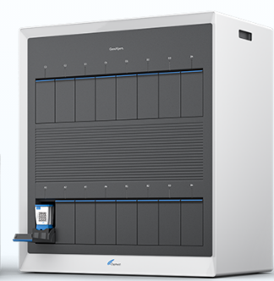
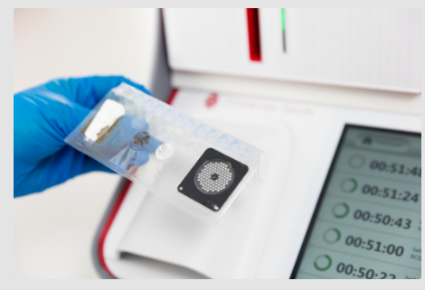
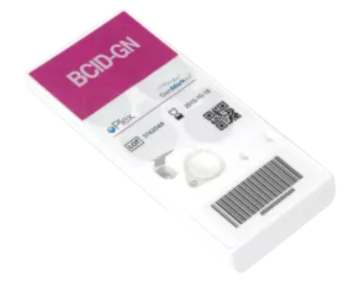
Carbapenemase detection: genotypic
Cepheid Carba-R
  Detects the five most common genes
  Can be used for surveillance (fecal swabs)
  Can be used to confirm a susceptibility result from bacterial colonies
Blood culture panels (used on positive blood cultures)
  BioFire FilmArray BCID2
    Detects the five most common genes
  GenMark ePlex BCID-GN
    Detects the five most common genes

Slide 41

Example 1: CRE?

Slide 42
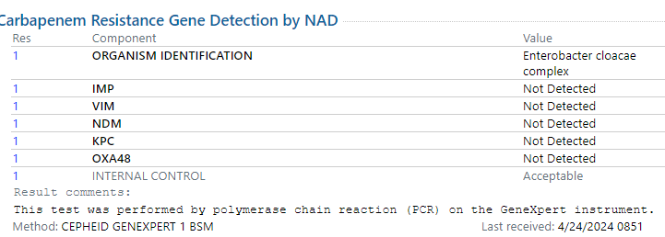
Example 1: CRE?

Slide 43
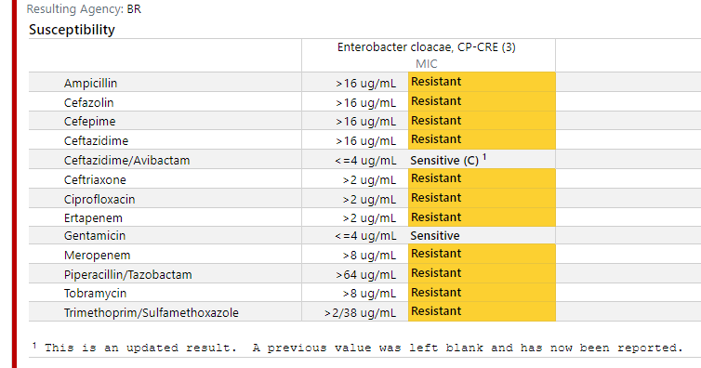
Example 2: CRE?

Slide 44
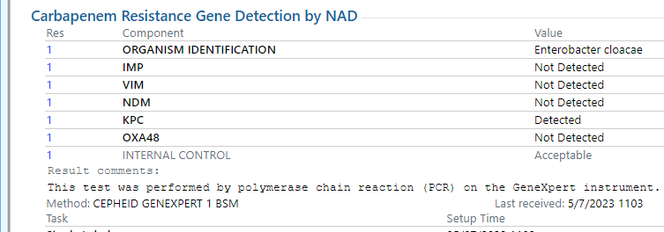
Example 2: CRE?

Slide 45
So why do we care about CRO’s?
Very tough to treat
  Carbapenems are a “last resort” antibiotic for Gram-negative bacteria
  CRO’s tend to be resistant to several other antibiotics also
CRO’s have higher mortality than susceptible organisms
It takes longer to initiate appropriate antibiotic therapy for CRO’s

Slide 46
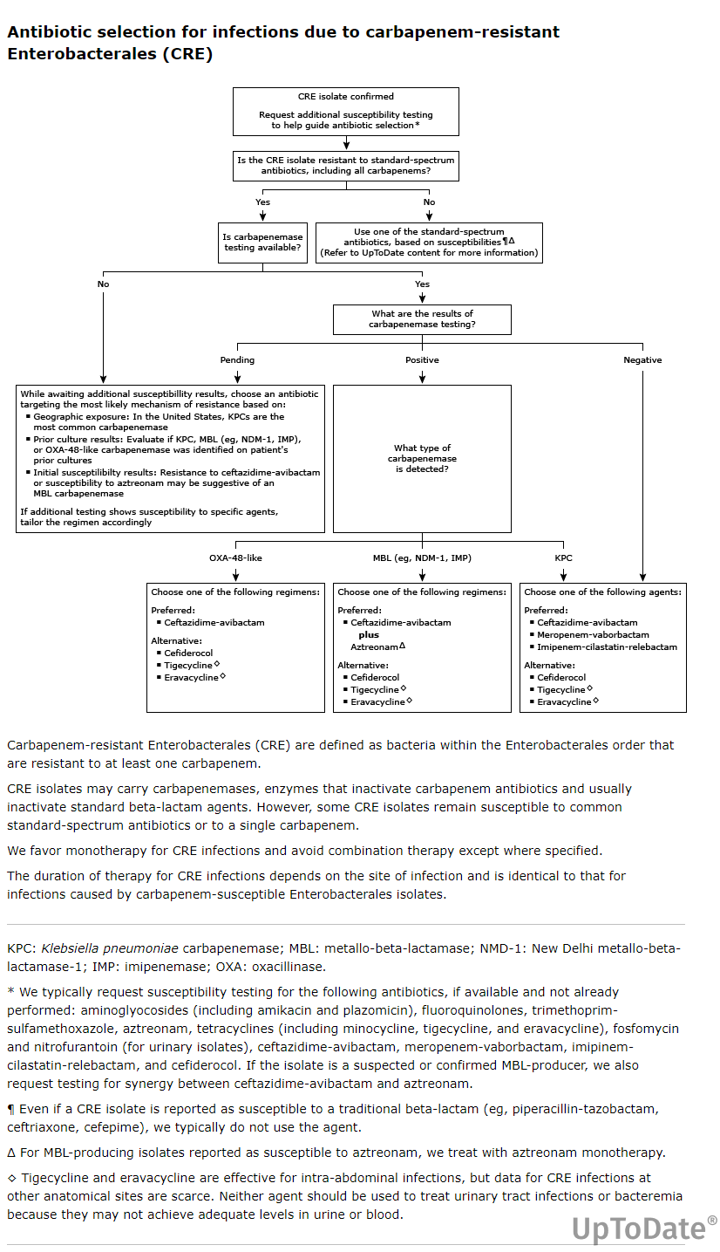
UpToDate: Carbapenem-
resistant E. coli, K. pneumoniae,
and other Enterobacterales (CRE)

Slide 47
UpToDate: Carbapenem-
resistant E. coli, K. pneumoniae,
and other Enterobacterales (CRE)

Slide 48
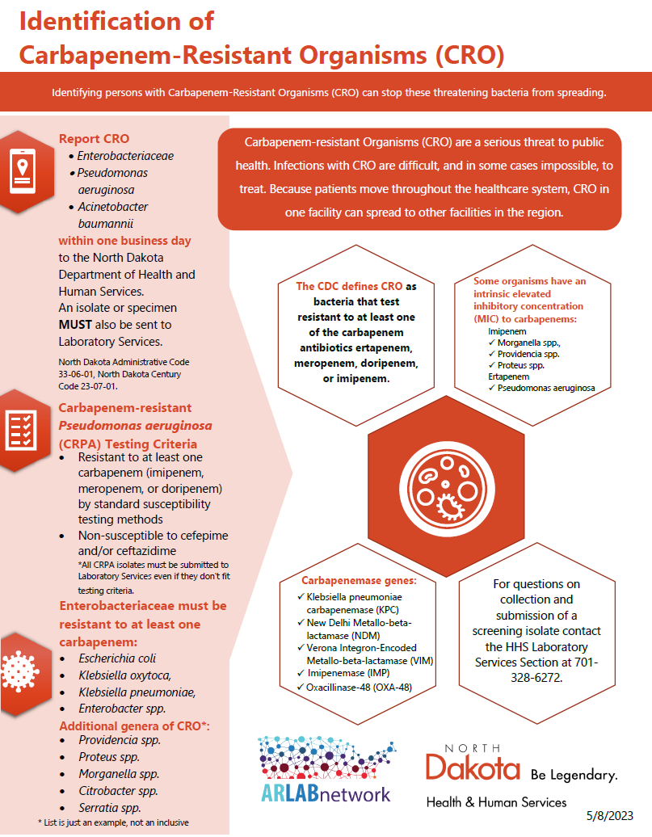
CRO are reportable in North Dakota
Pseudomonas aeruginosa:
Resistant to at least one carbapenem
Non-susceptible to cefepime and/or ceftazidime
Enterobacterales (not organism specific):
Must be R to at least one carbapenem

