Slide 1
Business Meeting April 26, 2024

Slide 2
Thank you to those who put this meeting together.
Mary Nagel - Committee Chair
Michelle Steiner, Jessica Fry, Christie Massen, Kimberly Peterson, Cassandra Pippenger, Robert Arndt, Patricia Weisback, and Sharon Reistad
Mary Coleman – PACE coordinator
Jessica Fry– Web master and Online registration
Notes:
Ask if all members have voted. If not have them scan QR code and vote.

Slide 3
ASCLS MISSION
The mission of ASCLS is to make a positive impact in health care through leadership that will assure excellence in the practice of laboratory medicine.

Slide 4
ASCLS BELIEVES
Quality laboratory service is essential to quality health care.
Competent, credentialed, laboratory professionals are the foundation to quality laboratory medicine.
Everyone deserves access to safe, effective, efficient, equitable, and patient-centered health care.
Advancing the laboratory profession advances health care.
Adopted by the ASCLS House of Delegates July 2011.
Notes:
Pick up election forms

Slide 5
2023 - 2024 in Review
April
2023
State Meeting in Minot
April 27-28
June
2023
National Meeting
In person and Virtual Meeting Held in Providence, RI
June 26-30
September
2023
April
2024
ASCLS-ND State Meeting in Bismarck, ND
April 26th
Board Elections
September
2024
June
2024
Legislative days in Washington DC. Oct. 23-24
ASCLS National meeting in Pittsburgh, PA
July 8-12
Region V Symposium Fargo, ND
Oct 10-11
Region V Symposium, Eau Claire, WI
Sept. 28-29
October
2024
Legislative days in Washington DC
Sept 30 – Oct 1

Slide 6
Business Meeting
Roll Call & Greetings
Approval of April 28, 2023 Minutes

Slide 7
Vote on Minutes
Discussion / Questions
Vote for approval or append

Slide 8
ASCLS-ND 2024-2025 Treasury Report
TREASURER: Jessica Fry

Slide 9
Balances
Account | Balance *as of 4/21/2024
Business Checking 0% Interest | $16045.93 *$5116.09 ASCLS-ND *10,929.84 Seed Money for Region V
Business Money Market Savings 0.35% Interest | $873.40
60 Month Business CD 2.15% Interest | $10,510.30
12 Month Business CD 3.1% Interest | $5,655.78
6 Month Business Rel CD 4.94% Interest | $20,000.00
Managed by Jessica – See Excel document for itemization

Slide 10
Checking Account – Credits
Credit | Amount
State Dues (Not Received) | $ NA
ND State Meeting Deposit | $3137.90
Region V Profit Sharing | $2574.71
Paypal account (Deposited to Cornerstone Bank Acct) | $ NA
Total Credit: | $ 5712.61

Slide 11
Checking Account – Debit Summary
Debit | Amount
2023 Student Scholarships | $ 1500.00
2023 ASCLS Annual Meeting | $ 6025.04
2023 Region V Fall Symposium/Leadership Academy | $ 1377.64
2023 Legislative Days | $ 2522.88
2023 (Nov) PACE Dues | $ 450.00
2024 Website | $ 324.00
2024 ND State Science and Engineering Fair | $ 300.00
Total Debit: | $ 12,499.60

Slide 12
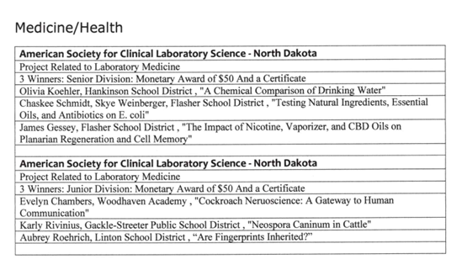
ND State Science and Engineering Fair

Slide 13
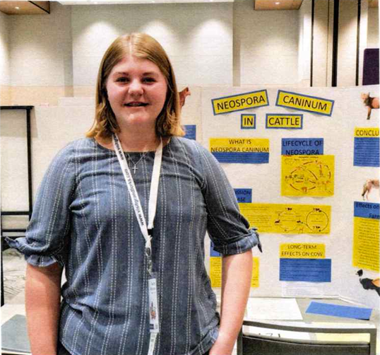
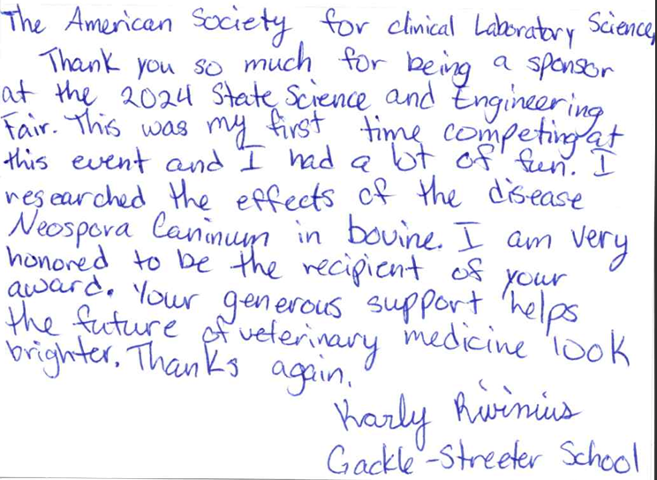
ND State Science and Engineering Fair

Slide 14
Current Financial Report
Motion to approve?

Slide 15
Membership
ASCLS-ND Membership Chair
Sharon Reistad
Membership Packages
https://ascls.org/membership/membership-packages

Slide 16
State Science Fair Winners 2024
American Society for Clinical Laboratory Science
North Dakota Chapter
Provides a monetary award of $50 and a certificate to the Projects Related to Laboratory Science in the Junior and Senior Division.
This year Sharon Reistad was able to present the winners with their awards and take pictures of the 7 winners.

Slide 17
Aubrey Roehrich - "Are Fingerprints Inherited?" from Linton Public School Evelyn Chambers - "Cockroach Neuroscience: A Gateway to Human Communication” from Woodhaven Academy Karly Rivinius - "Neospora Caninum in Cattle” from Gackle-Streeter Public School
J
U
N
I
O
R
D
I
V
I
S
I
O
N

Slide 18
S
E
N
I
O
R
D
I
V
I
S
I
O
N
Olivia Koehler - "A Chemical Comparison of Drinking Water" from Hankinson Public School
Chaskee Schmidt & Skye Weinberger - "Testing Natural Ingredients, essential oils and antibiotics on E. coli" from Flasher Public School
James Cessey - The Impact of Nicotine, Vaorizer, and CBD Oils on Planarian Regeneration and Cell Memory" from Flasher Public School

Slide 19
Region V Update
Tammy Windish/Sharon Reistad
Region V committee is made up of the 3 P’s from each state: ND, SD, WI, MN 3P’s are: Past President, President and President Elect
http://www.regionvascls.online/

Slide 20
Region V - Leadership Academy
Applications available now for 2024-2025 class
North Dakota Contacts for Region V
Leadership Academy:
Sharon Reistad
sreistad@srt.com
Tammy Windish
windishtammy@gmail.com
Regional Program Benefits
Minimal time away from home
Cost is less at Regional level than the National Leadership Academy
Learning the importance of Teamwork in the Laboratory
Mentors that you work with will help you through out your career
A chance to learn management skills that will advance you in your profession.
Meeting friends that share your professional interests.

Slide 21
ASCLS Advocacy
Legislative Days
Was held October 23-24 2024
ND sent Sharon Reistad and Samantha Urbanec to represent ND and visit with legislators.
Notes:
Sharon and/or Samantha could you please tell us about the topics that were discussed and who you were able to talk to.

Slide 22
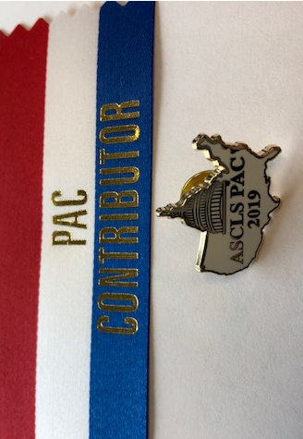
ASCLS PAC & GAC
PAC allows our members to donate to the ASCLS PAC so that we can provide support to specific Senators and Representatives in Washington DC who support our position on issues or specific legislation. ..Small contribution but symbolic…
The GAC works with our legislative consultant and our executive vice president (EVP) to determine what our positions are on legislative and regulatory initiatives. That is why we comment on regulatory proposals and lobby in Washington DC.”
PAC pins for $ 40.00 & PAC ribbons for $20.00 or more
Notes:
ASCLS PAC has started to recognize donors to who give $300.00 or more to ASCLS PAC. The $300 donors were recognized at the house of delegates in the commendations and the board plans to investigate other ways to recognize donors. if you would like to donate to PAC or If you have questions about PAC you can email Mary Coleman at mcoleman1200@yahoo.com
PAC: Positive Action and Commitment The acronym PAC stands for “Political Action Committee,” a voluntary non-profit organization created to provide financial & educational support for the election campaigns of responsible candidates for Congress. All PAC’s are legal, ethical, and strictly regulated by federal law, which limits the amount of individual contributions and requires full and regular disclosure. ASCLS/PAC offers members a simple, convenient way to influence the elections process and actively participate in the federal decision-making process. Through the PAC, ASCLS members are able to unite together to gain the attention of candidates for national political office. Your support and generous contributions to the ASCLS/PAC represents your P-ositive A-ction and C-ommitment.
a PAC of an organization raises money privately to influence elections or legislation, especially at the federal level. It allows us as individuals to combine our funds with other members of ASCLS to have more influence than we would have individually.

Slide 23
Election Voting at Nationals Please feel free to go to this website https://ascls.org/meet-the-candidates-2024/
Looking at the candidates running for National Board that the North Dakota Delegates will be voting for unless other candidates are suggested:
Nominations Committee: Our own Brooke Solberg
National Board of Directors: 9 Candidates running for 4 – 3 year term positions and 1 – 1 year term position: Melissa Casper of Wisconsin, Kelcey Harper of Central New England, Stacie Robinson of Maryland, Stephanie Noblit of Pennsylivania, and Heather Harrington of Pennsylivania
President-elect: Miles Tompkins of Oklahoma

Slide 24
ELECTION RESULTS!
Nominations Chair: Hannah Hove

Slide 25
Congratulations!!
President - Elect -
Samantha Peterson – Grand Forks
Secretary/Treasurer Elect -
Jessica Fry
Ascending Professional -
Samantha Urbanec
Nominations Chair -
Katie Kucera
Board Member at Large -
Heather Mayers

Slide 26
AWARDS & RECOGNITIONS 2024

Slide 27
Developing Professional
The developing professional is a student member who is chosen by the board and will help lead and encourage other students to join and get involved with ASCLS. They will participate in board member and will have the opportunity to go to the national meeting as a delegate.
ASCLS-ND Developing Professional

Slide 28
Omicron Sigma – Presidents Honor Roll
First awarded in 1977, Omicron Sigma is the ASCLS President’s Honor Roll for Outstanding Service.
Recognition is at three levels: National, Regional and Constituent Society (State)
for dedicated members who volunteer their personal resources, time and energy to the ASCLS.
On behalf of ASLCS I would like to recognize the following individuals as recipients of the Omicron Sigma award for their significant contributions to ASCLS
ASCLS relies on dedicated volunteers such as you to move the profession forward.
Thank you so much for your contributions to our professional organization!

Slide 29
Omicron Sigma
Christie Massen
Sharon Reistad
Mary Coleman
Mary Nagel
Michelle Steiner
Jessica Fry
Alice Hawley

Slide 30
ASCLS – ND would also like to recognize the following non- members that helped put on our wonderful 2024 State Convention
Kimberly Peterson
Cassandra Pippenger
Robert Arndt
Patricia Weisback

Slide 31
Membership Awards
5 Years
Luke Huff Towle
10 Years
Jessica Fry
Samantha Peterson
15 Years
Melissa Saxlund

Slide 32
Membership Awards
20 Years
Shannon Jongeward
35 Years
Heidi Brosius
Lois Greisen
55 Years
Patricia Hanngl

Slide 33
KEY TO THE FUTURE AWARD
This award serves to recognize and reward ASCLS members who have demonstrated their leadership potential to the organization, and to provide these members with structured mentoring.
The 2024 Award Winner is
Samantha Urbanec

Slide 34
Member of the Year!
For
2024

Slide 35
Jessica
Fry

Slide 36
2024-2025 National Meetings
Legislative Symposium
September 30 – October 1 2024
Washington, DC
ASCLS National Virtual
And In-Person Meeting
July 8-12, 2024
Pittsburgh, PA
ASCLS REGION V
FALL SYMPOSIUM
October 10-11, 2024
Fargo, ND
ASCLS NATIONAL CONVENTION
June 8-16, 2025
Sacramento, CA

Slide 37
THANK-YOU!
See you next year at our
2025 ASCLS-ND State Meeting in
Grand Forks!

Slide 38
Can I have a motion to Adjourn
It there a second?
Any questions?
All in favor?

